Slide 1
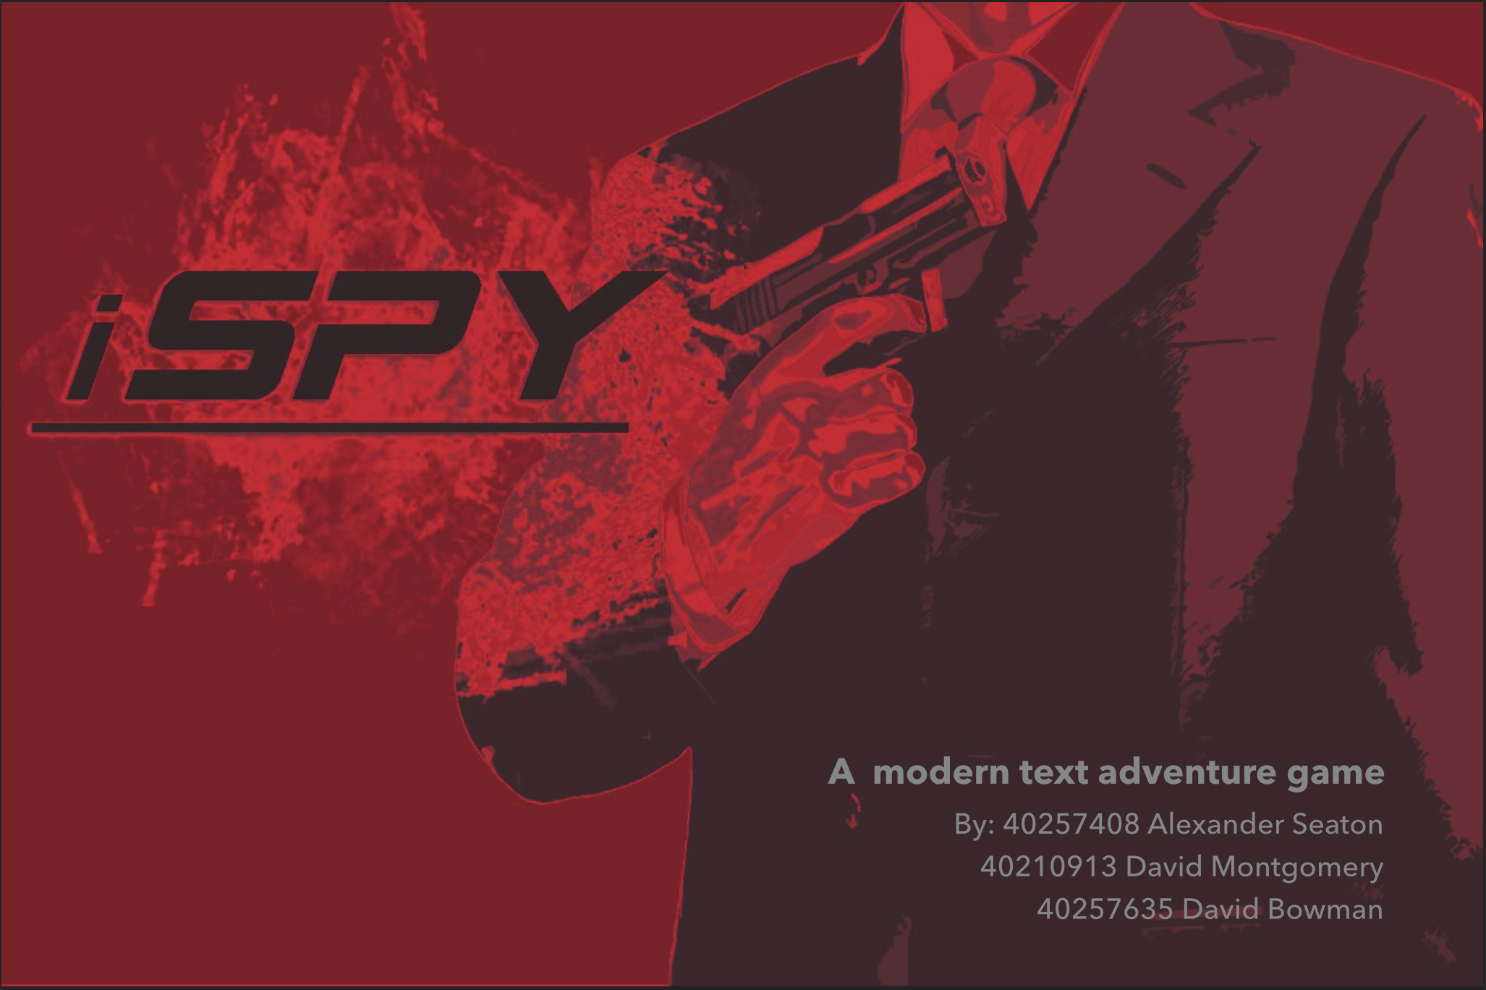

Slide 2
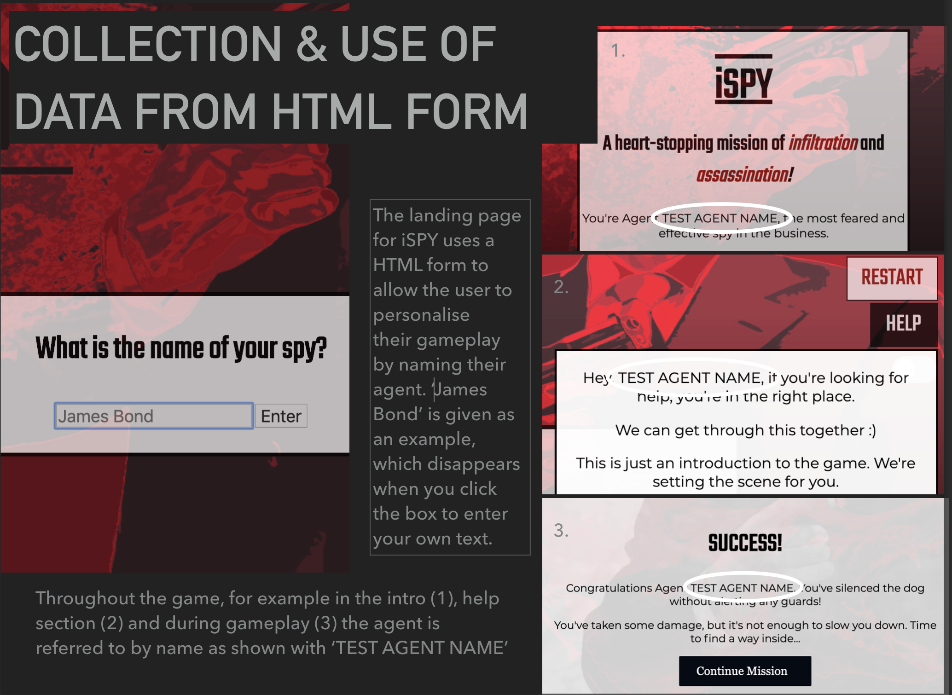
- 1

Slide 3
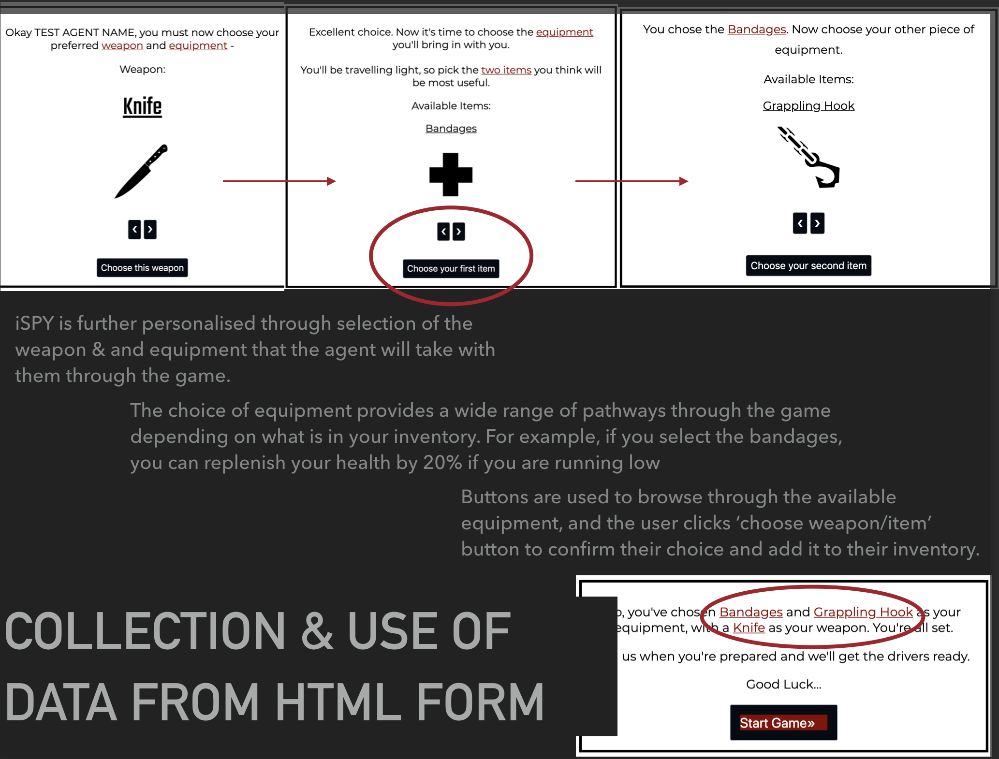
- 2

Slide 4
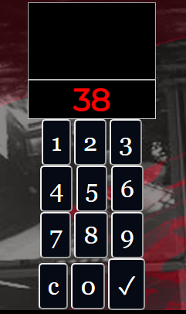
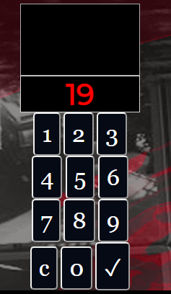
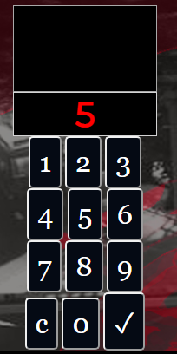
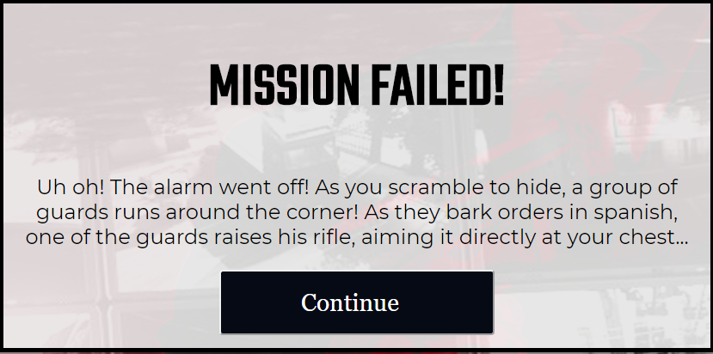
JavaScript Timed Event - 1
The screenshots show the flow of the alarm stage of iSpy. The timer on the alarm ticks down, starting at 40. If it reaches 0, the player loses the game as demonstrated to the right.

Slide 5
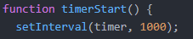
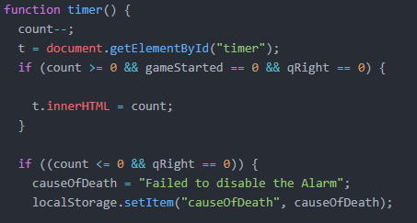
JavaScript Timed Event - 2
The timer function uses the count variable, which defines how long the timer runs for, so for this game, 40000 milliseconds or 40 seconds.
The timerStart function kicks off the timed event by setting an interval of 1000 milliseconds, each time running the timer function.
The function itself reduces count by 1 every time it runs, checking that the count is still greater than 0 and that the user has not yet gotten the alarm code right. If this is true, it updates the timer display so that the user can see how much time they have remaining.

Slide 6
Text Adventure Elements - 1
This flowchart illustrates all of the possible paths a player can take during the escape sequence of iSpy.
If player has enough health
Left Door
Downstairs
Yard
Search
Montoya
Right Door
Escape
Upstairs
Barracks
Hide
Any other name
Death
Vent
If player has walkie talkie
If player has grappling hook

Slide 7
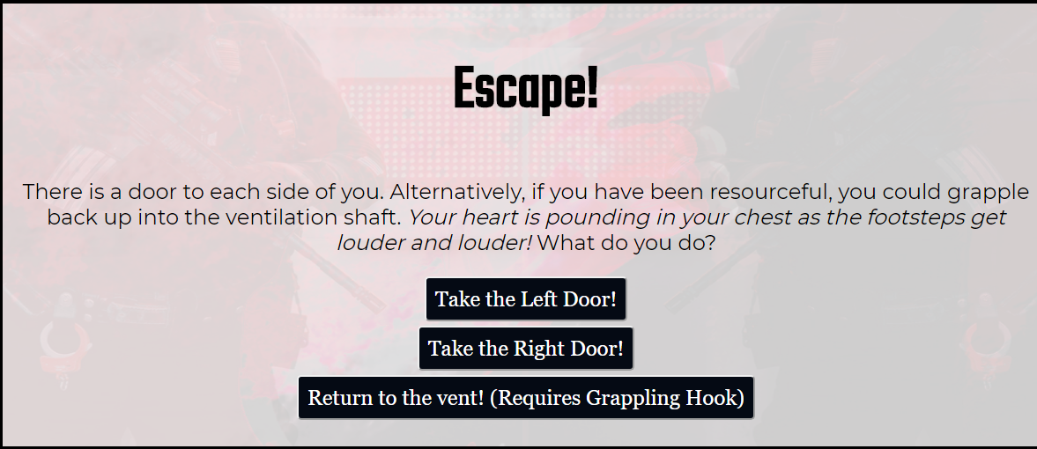
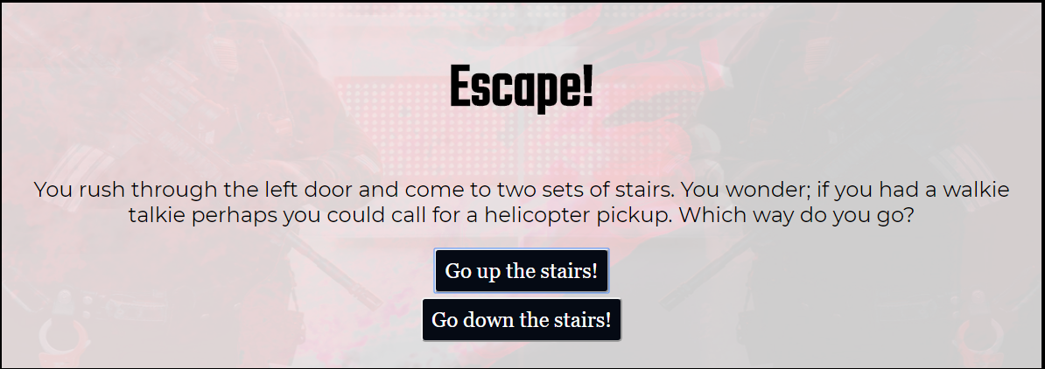
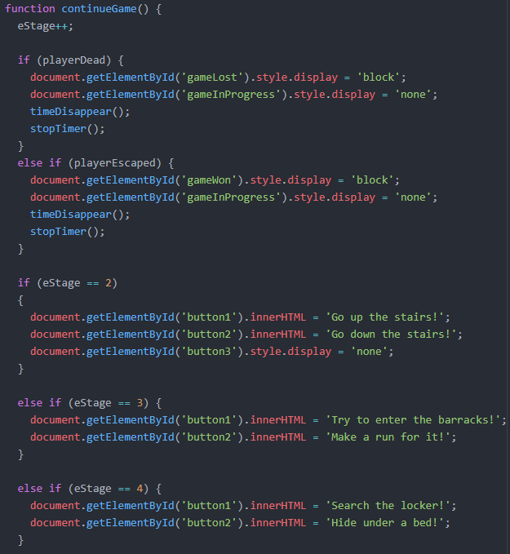
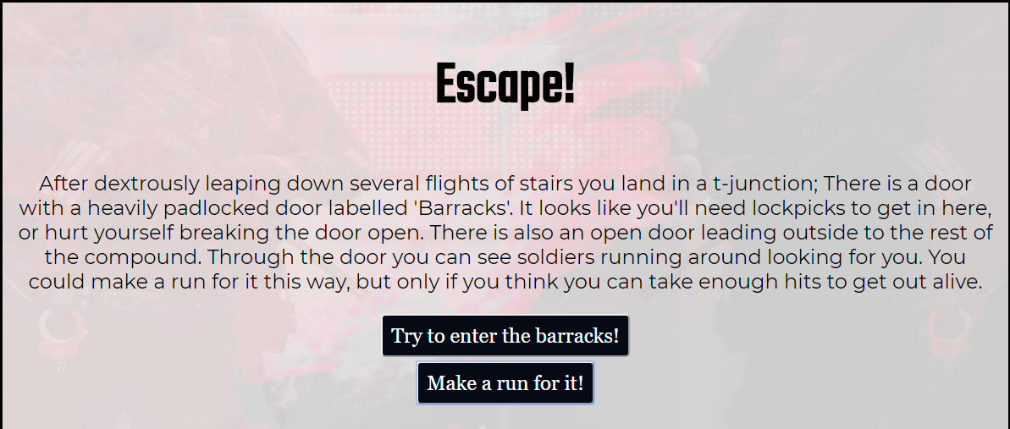
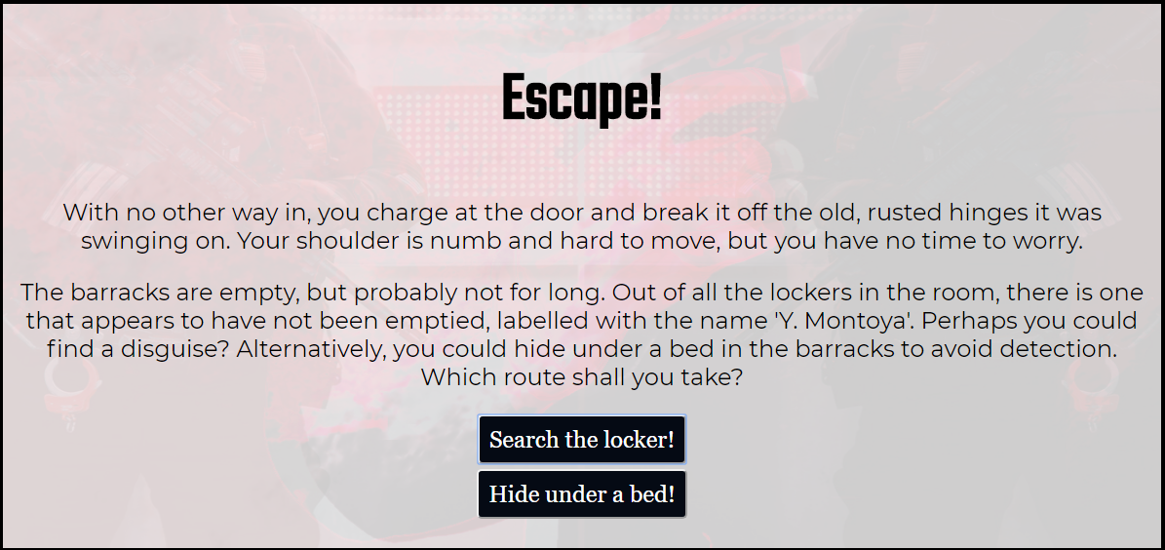
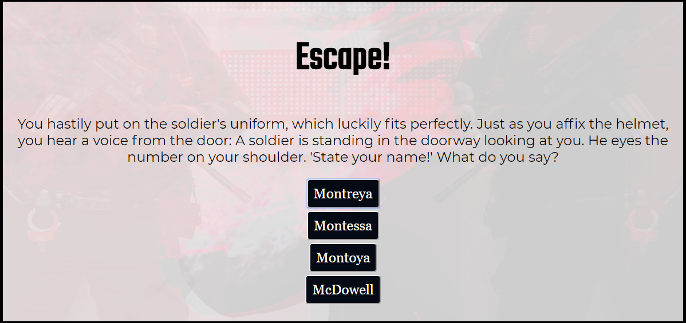
Text Adventure Elements - 2
The operation of the escape sequence was completed using a staged based system. The driving function was continueGame, which changed all of the text elements on the page depending on what stage the player was currently at.
Stage 1:
Stage 2:
Stage 3:
Stage 4:
Stage 5:

Slide 8
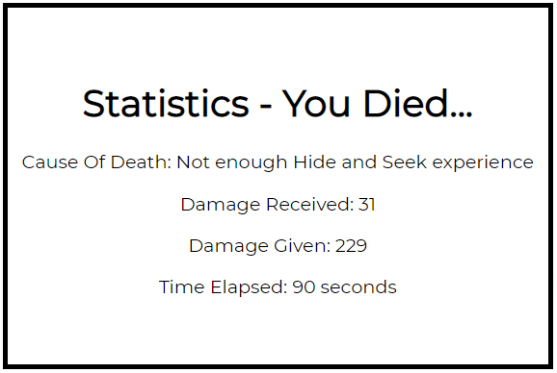
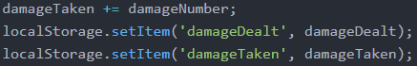
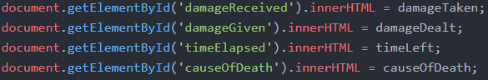
COLLECTION OF DATA TO USE AS STATISTICS
The time elapsed statistic is taken from the overall 5 minute timer variables. The time left is taken from 300 (seconds) to give how long has passed in seconds.
Throughout the Dog Fight, Boss Fight and the Escape Sequence, any damage dealt by or taken by the player is added to the relevant variable.
They are then stored in local storage so they can be accessed across pages. The numbers are parsed as Integers when they are taken out of local storage because they are stored as strings.
On the statistics page the values are simply assigned to the innerHTML attribute of different spans within the HTML code

Slide 9
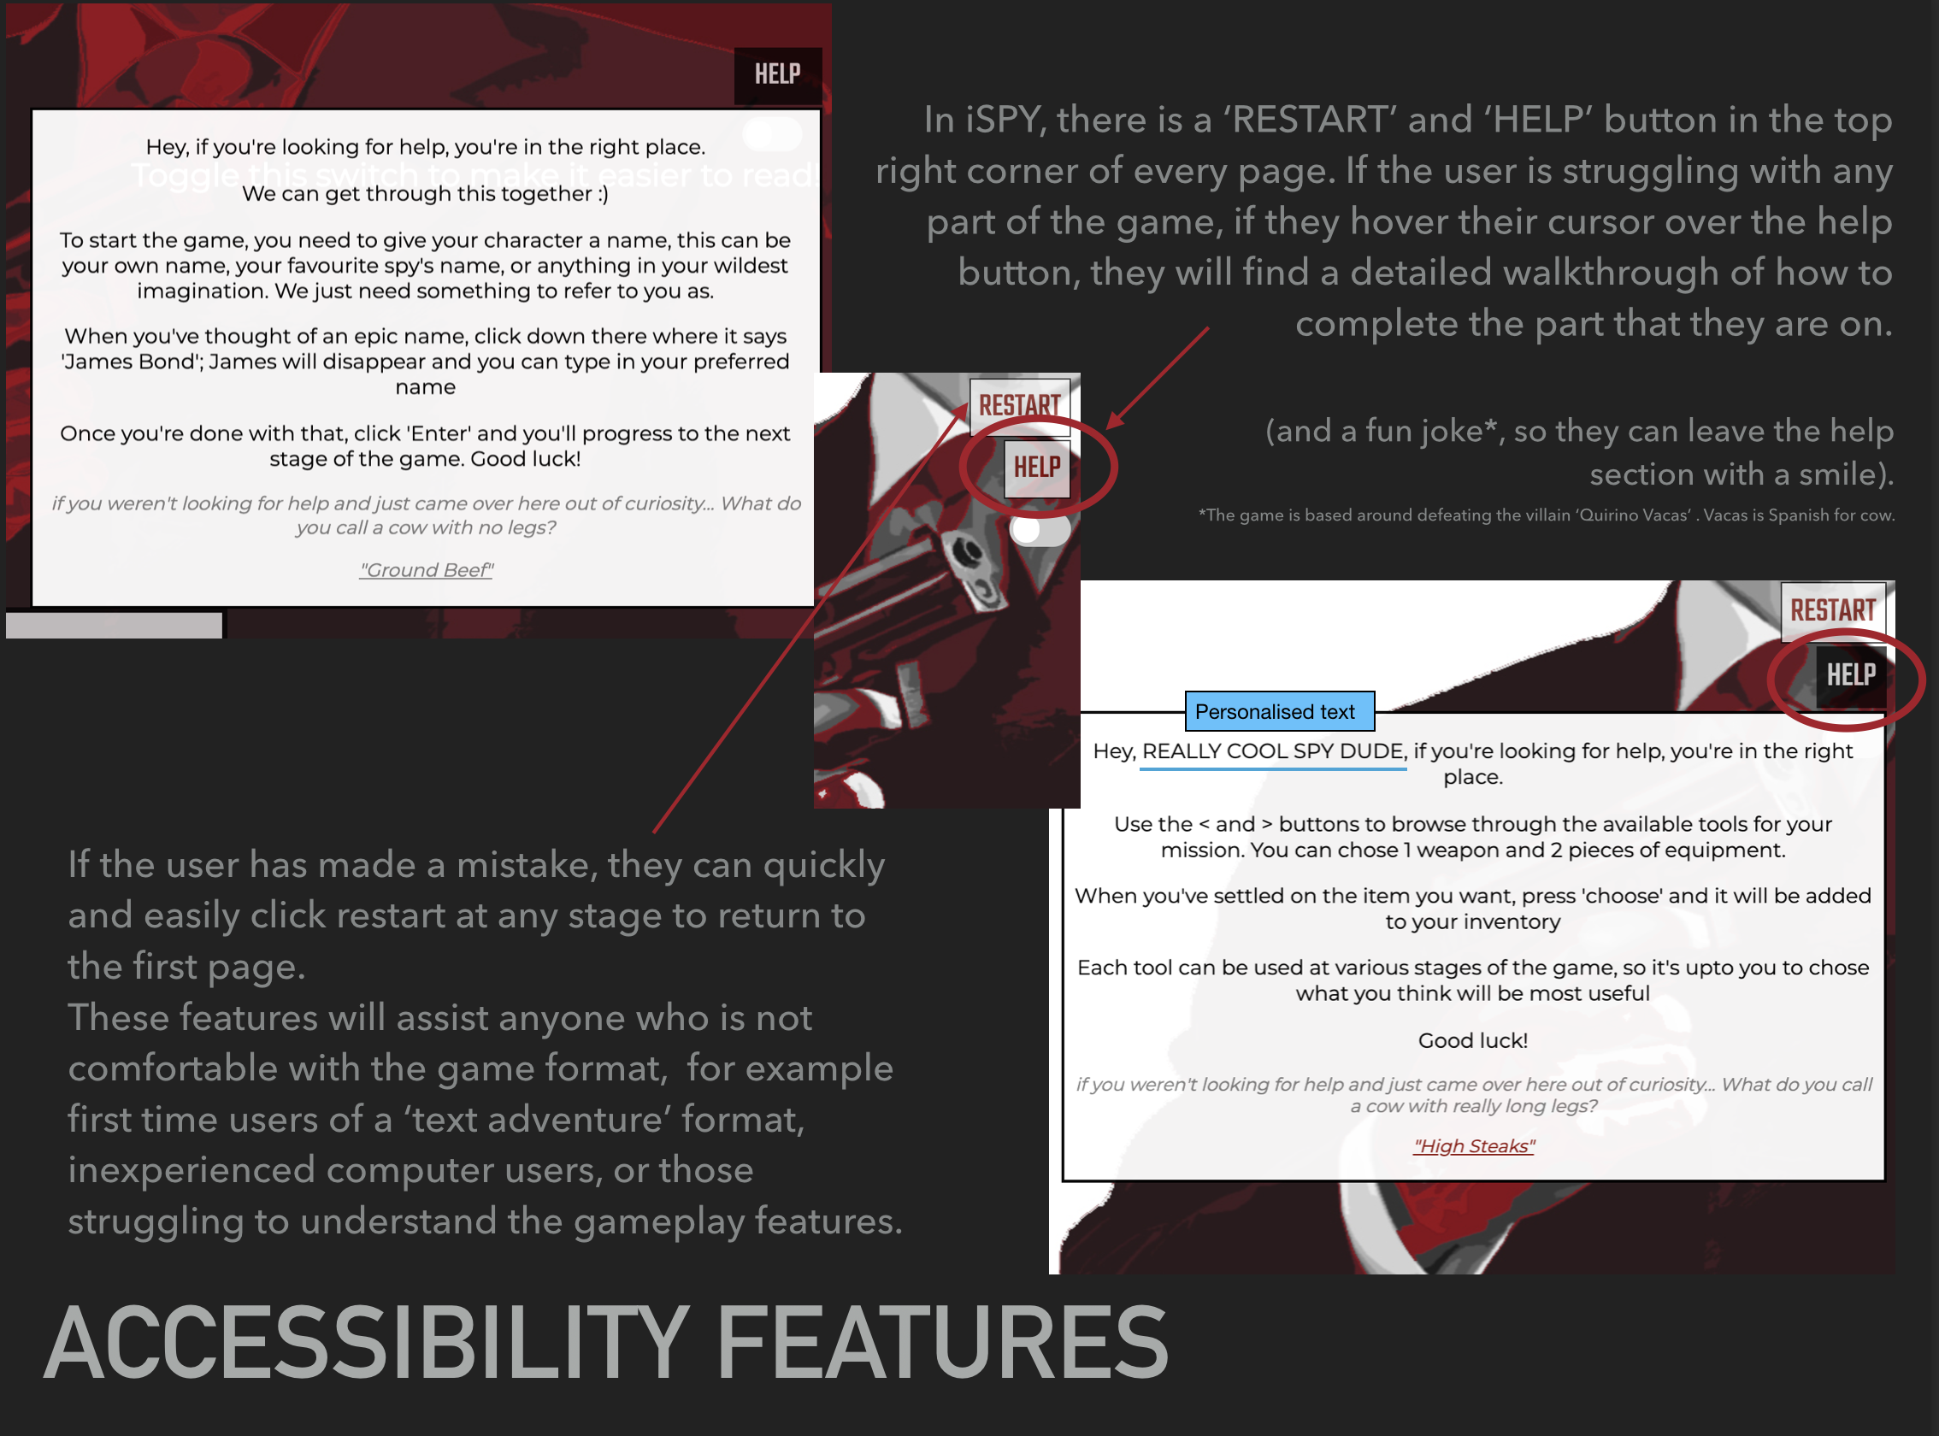
- 1

Slide 10
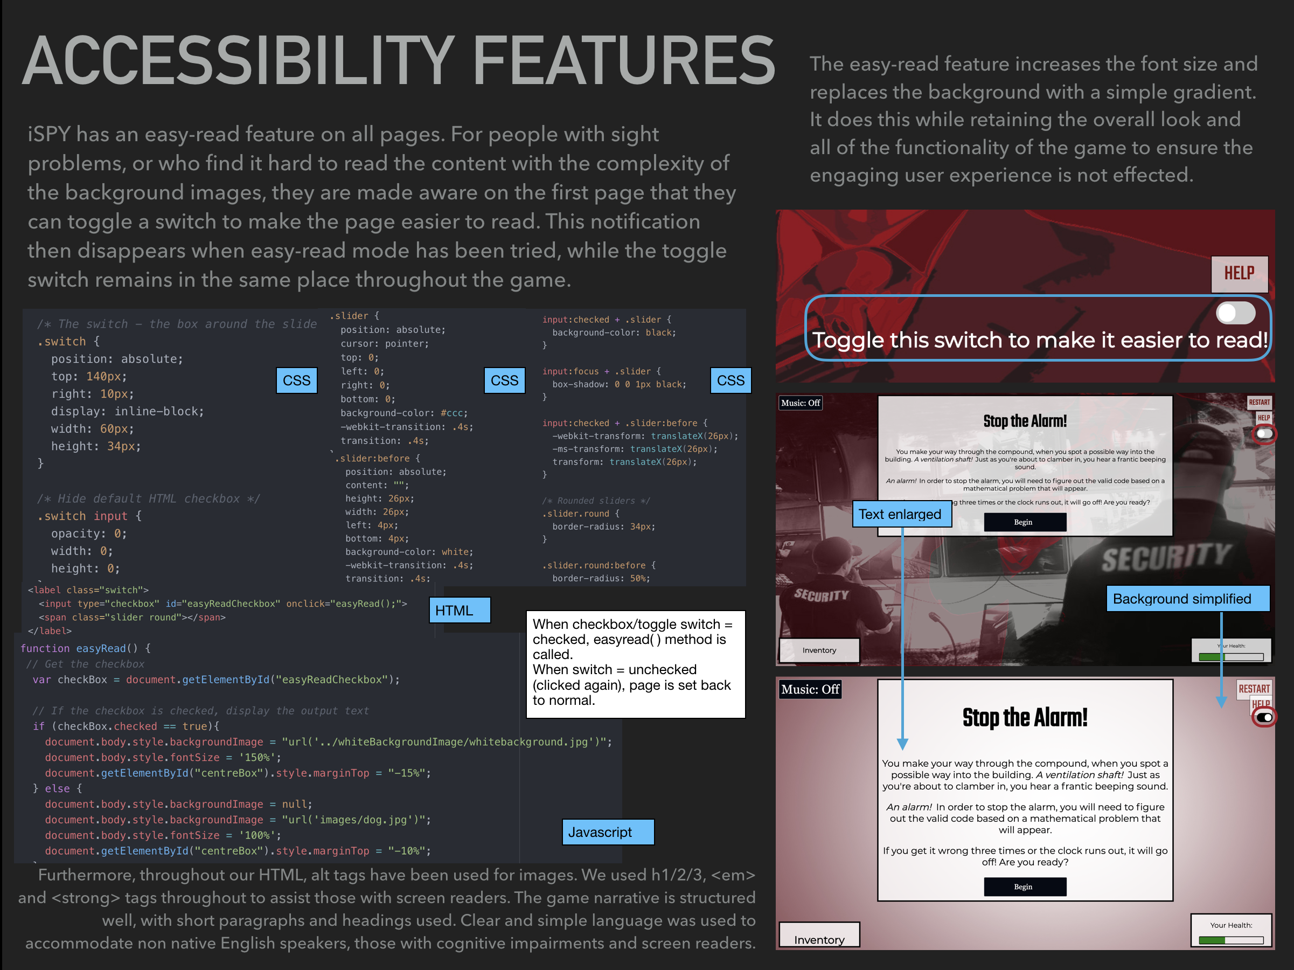
- 2

Slide 11
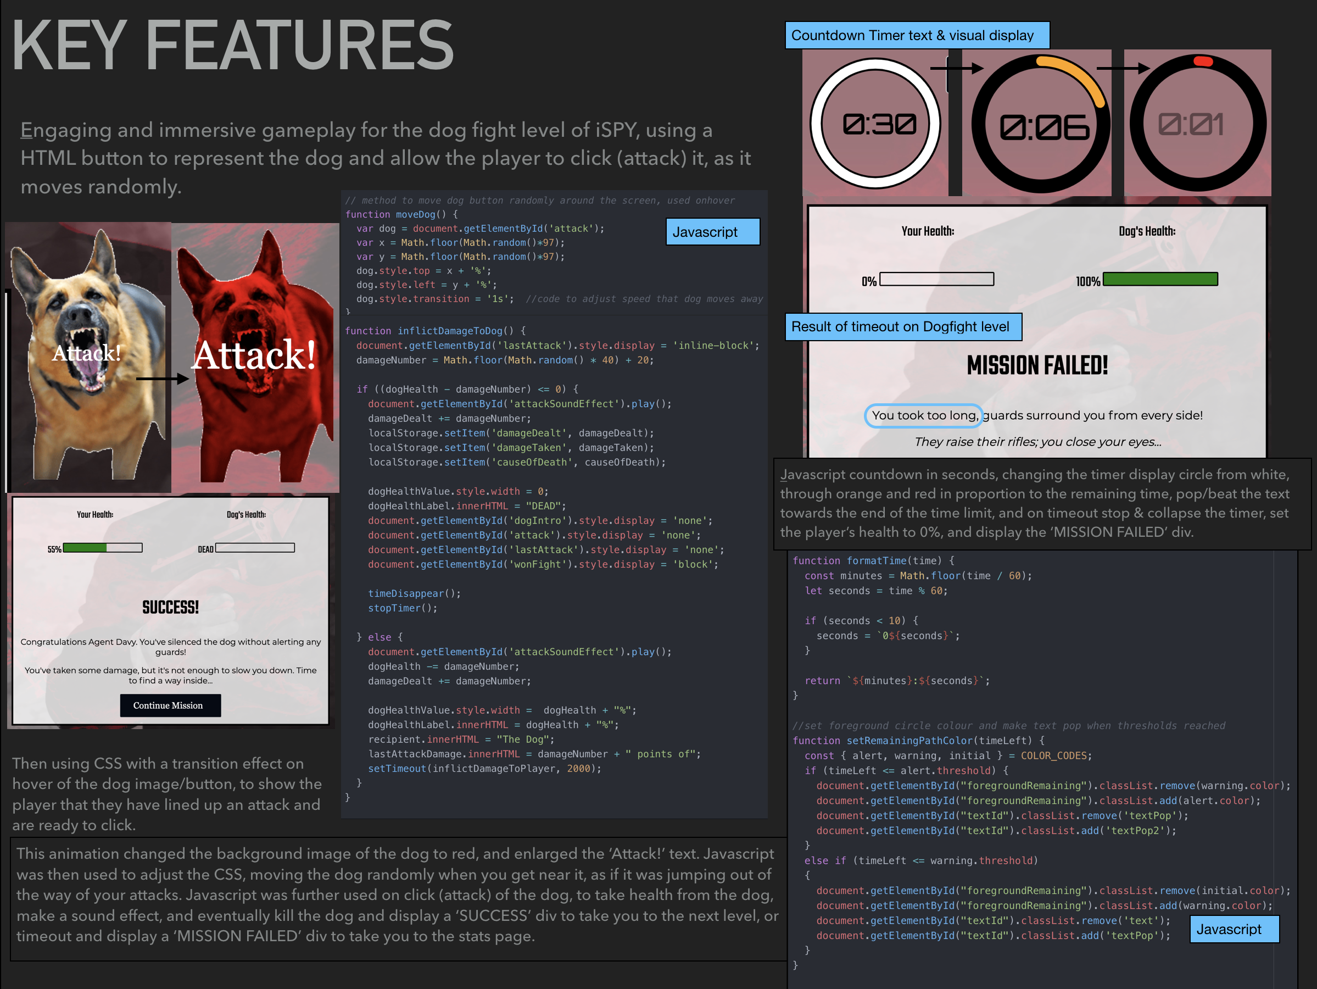
- 1

Slide 12
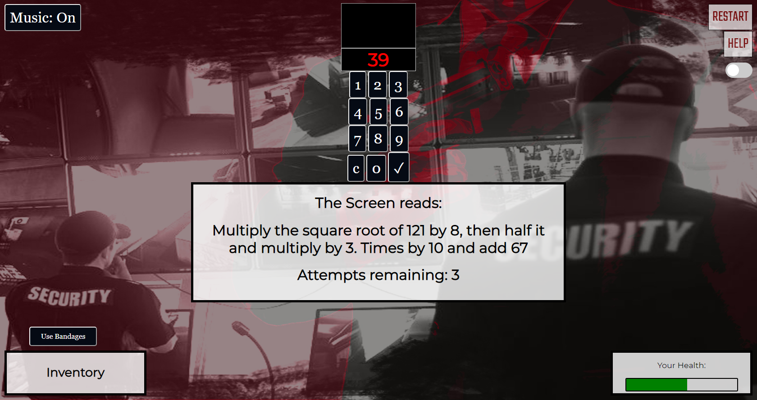
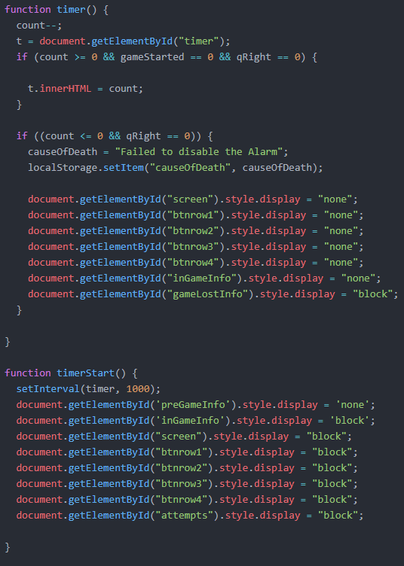
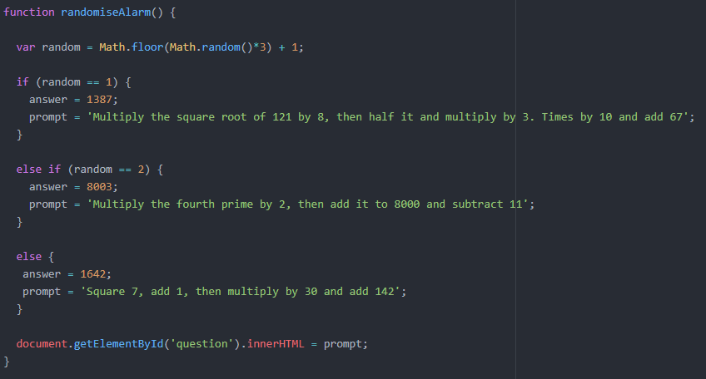
One of the features of our game that we think held the best user experience was the alarm stage of the game. The frantic nature of it, combined with the music and sound effects made it an immersive and engaging part of iSpy.
KEY FEATURES - 2
The timer particularly was one of the most complex parts of this stage.
As well as being one of the best user experiences in the game, it was relatively technically complex to complete in all three aspects of development, those being html, CSS and JavaScript.
The alarm also chose a random prompt when it loaded which helped to promote replay ability in iSpy. We hoped that this combined with our equipment system meant that the user could play our game in multiple different ways, getting a different outcome depending on their choices.

Slide 13
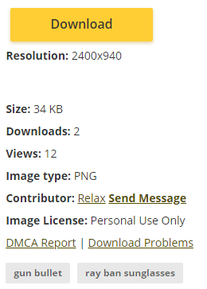





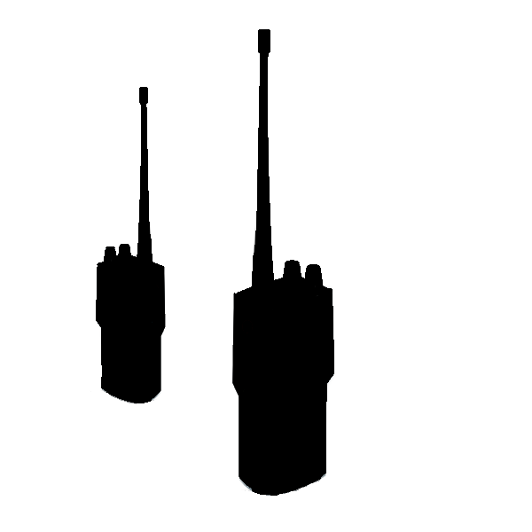
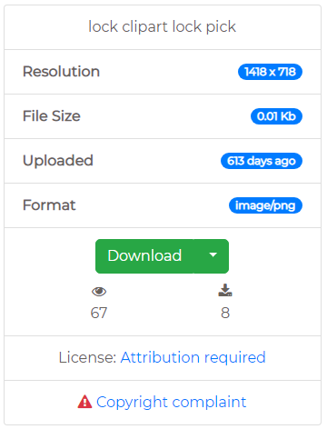
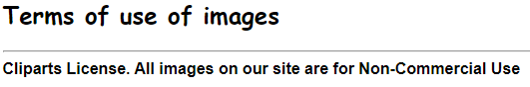





Image Attributions - 1
From flaticon.com and then edited to suit style
From pngitem.com and then edited to suit style
Made by David Bowman of Team 39
From clipart-library.com and edited to suit style :
From webstockreview.net and then edited to suit style :
From favpng.com :

Slide 14
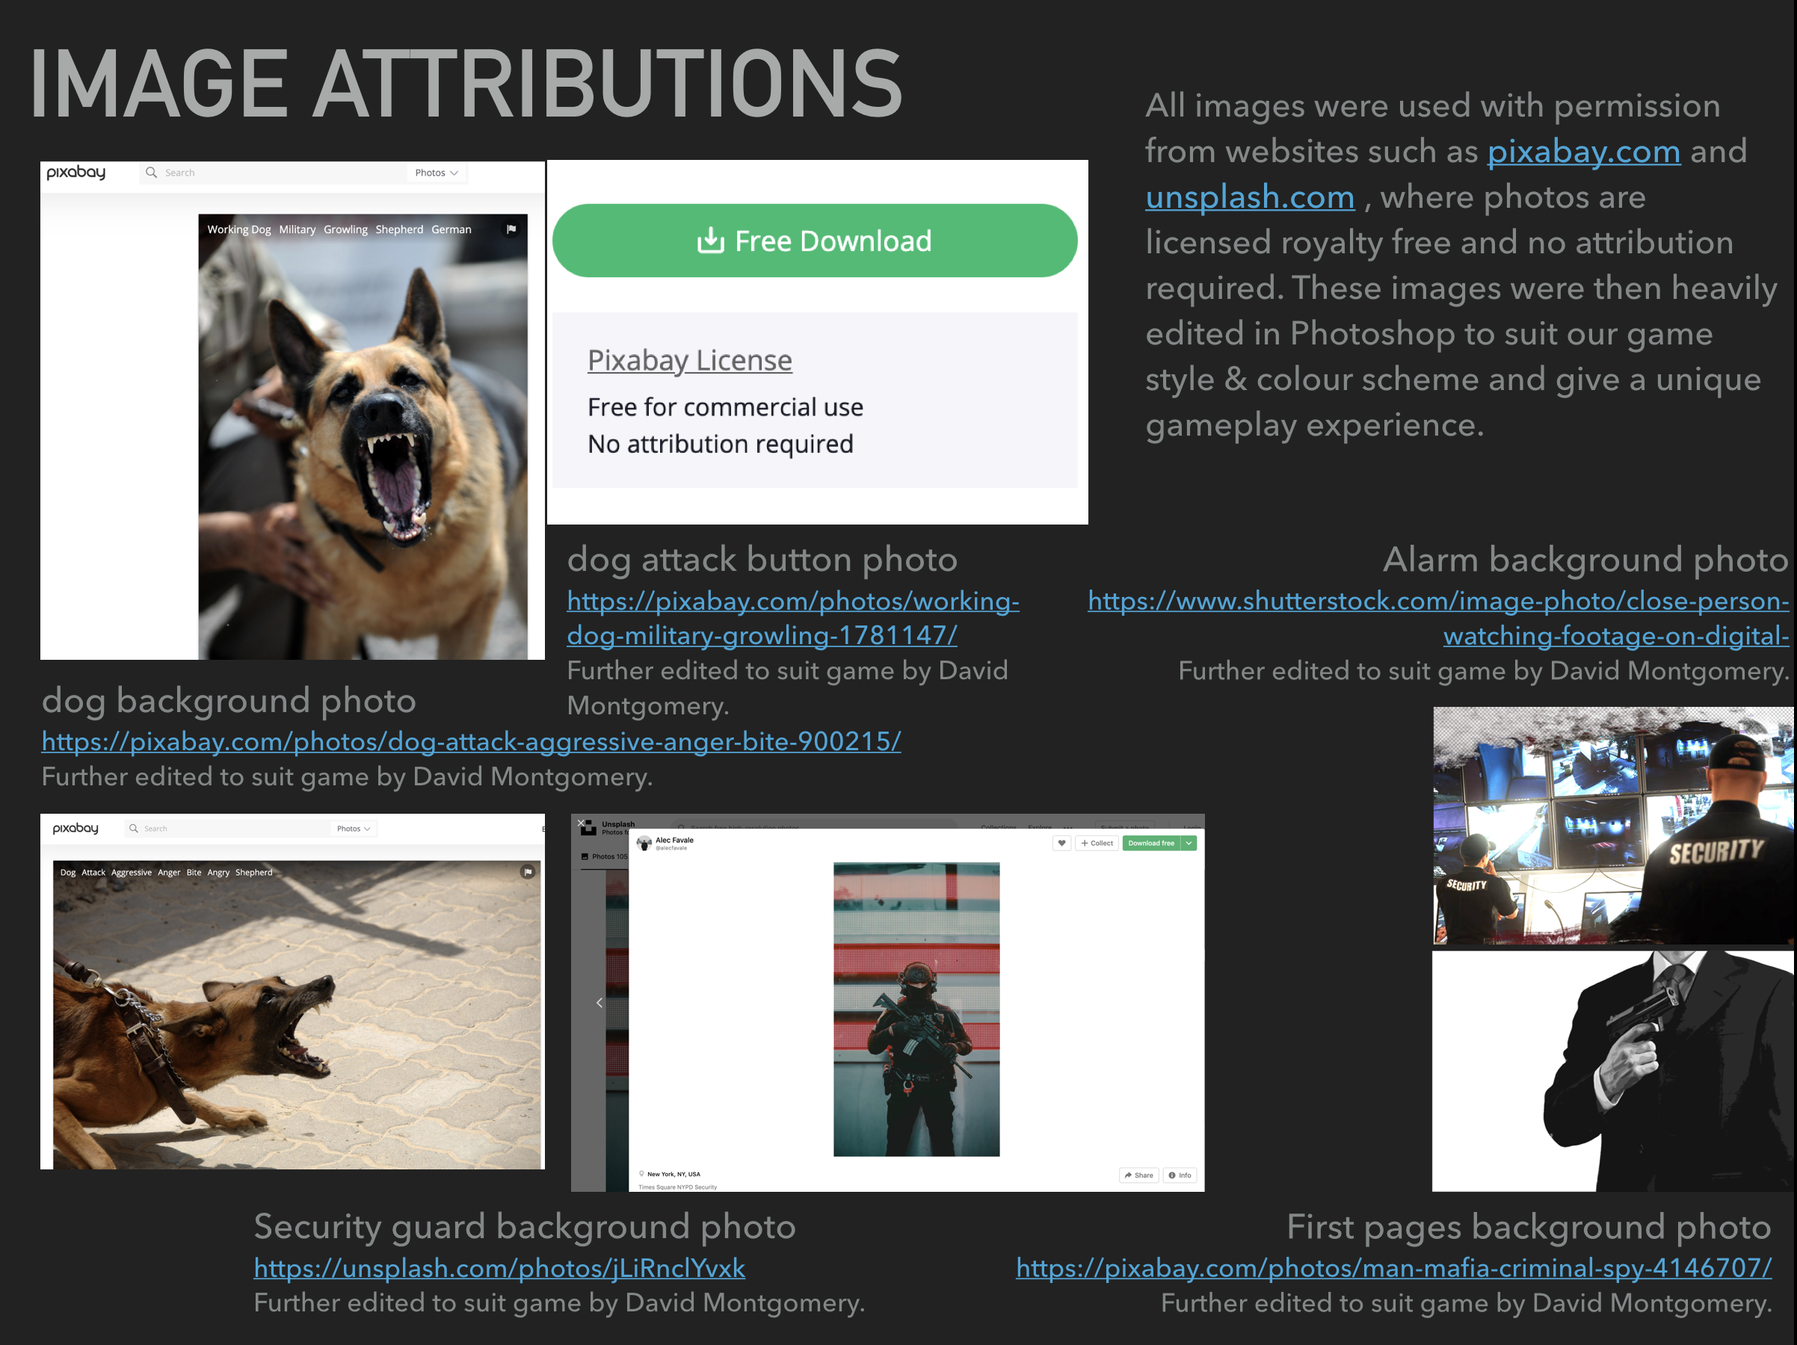
- 2

